Slide 1
CDS4004 – Lecture 3 Introduction to JS

Slide 2
Lesson objectives
Overview of JS
What is JavaScript?
What’s the difference between JavaScript and Java
Basic syntax of JS
Linkage between HTML and JS
Event Listeners
DOM manipulations

Slide 3
Overview of Javascript

Slide 4
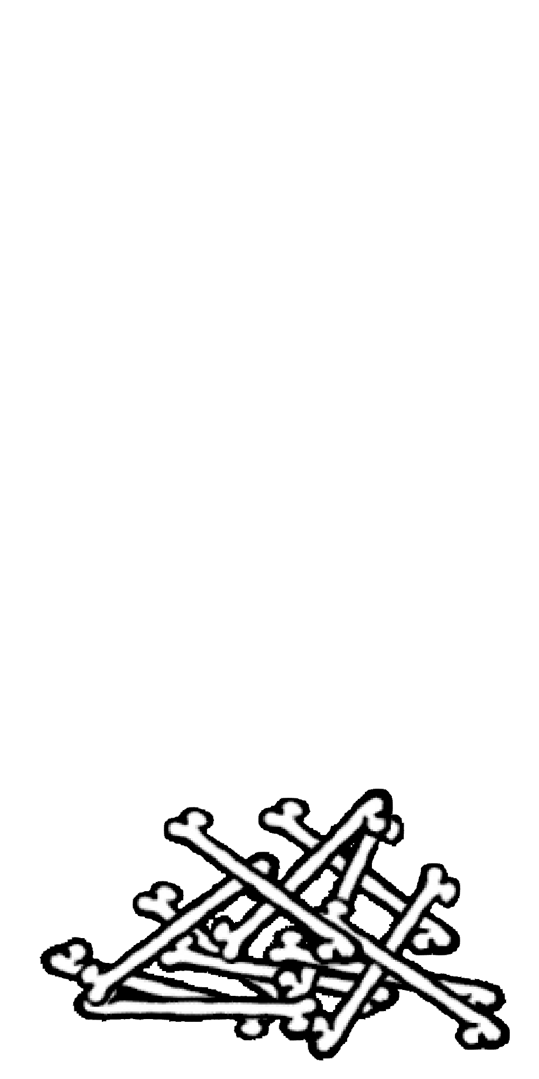
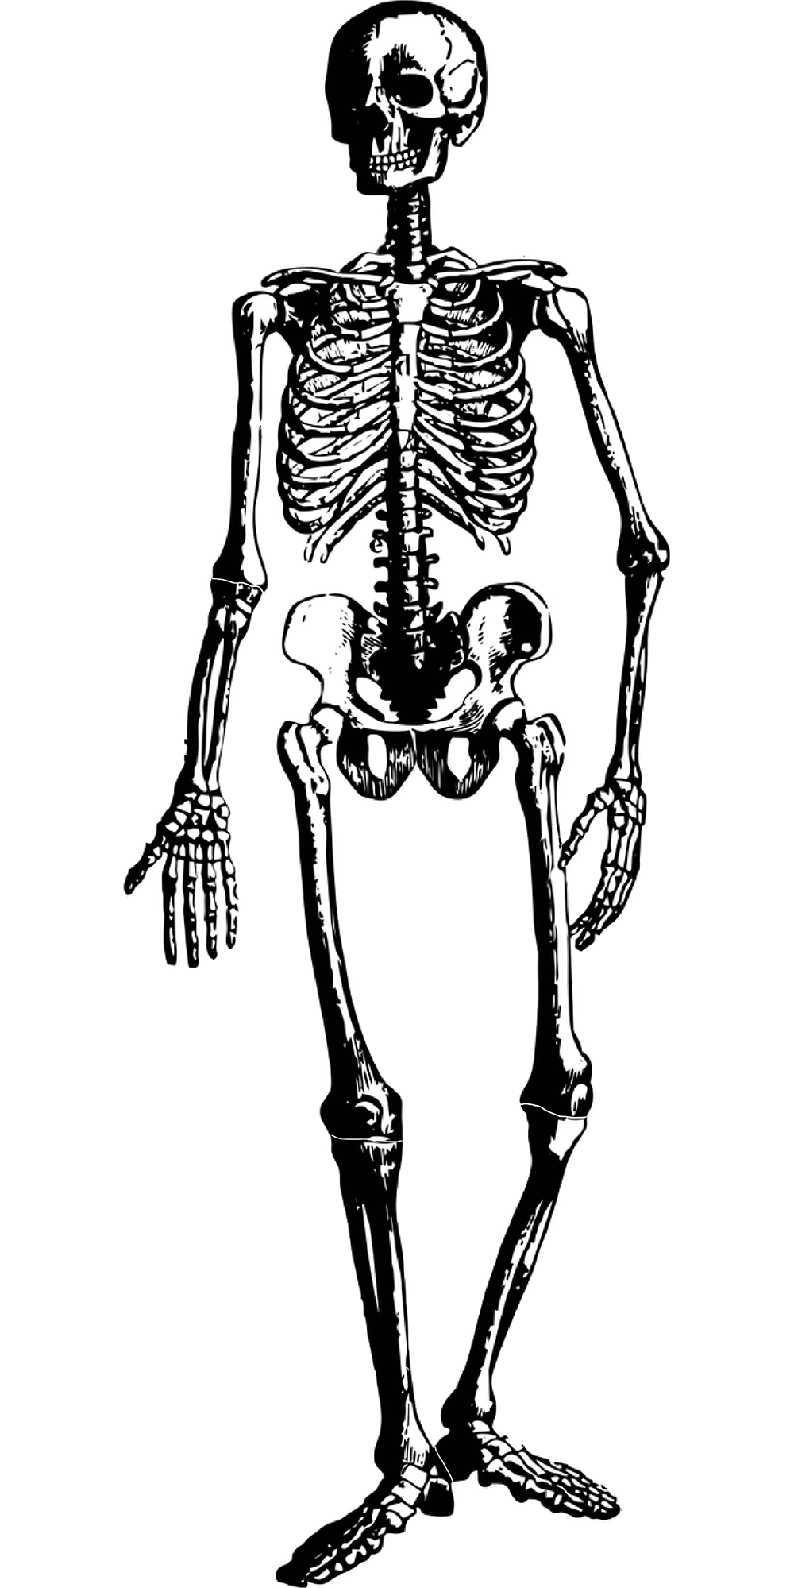
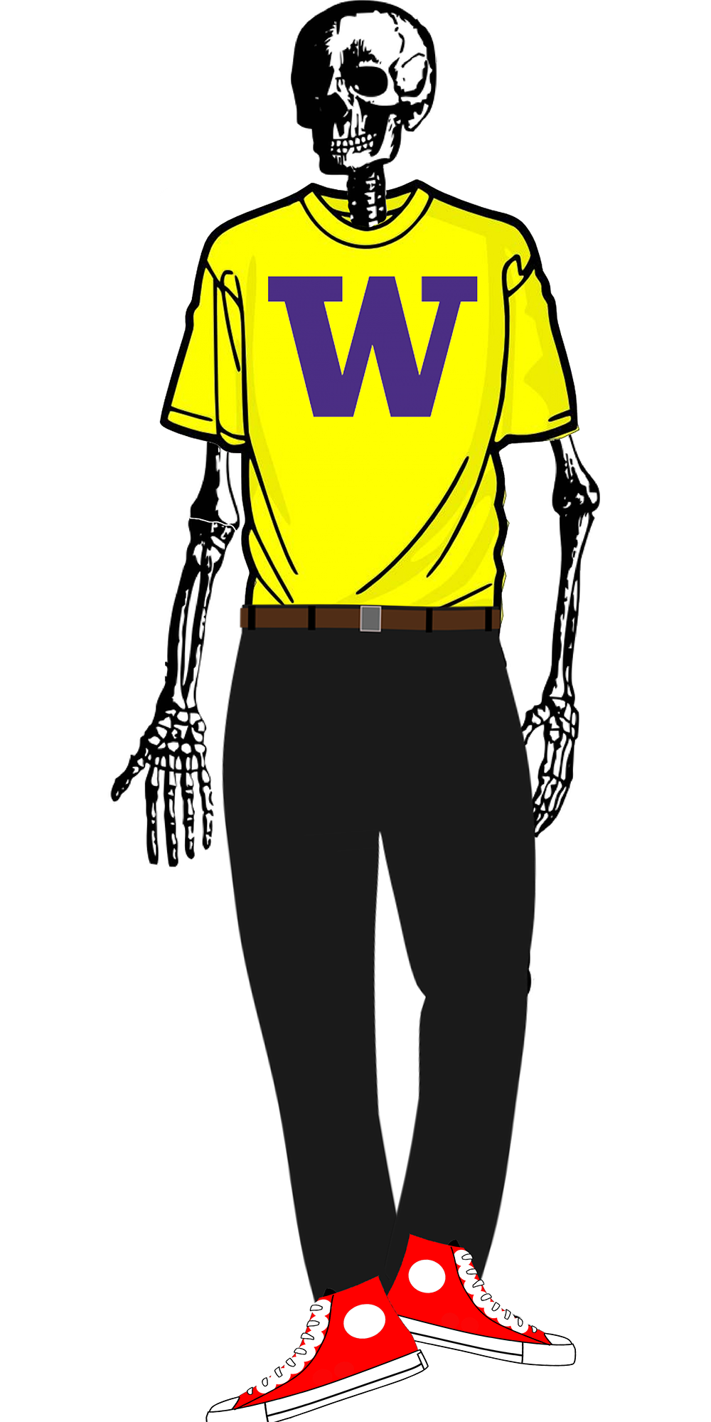
Terminology
Content
Structure
Style
Behavior
Words + Images
HTML
CSS
JS

Slide 5
What is JavaScript ?
JavaScript is a lightweight "scripting" programming language.
Lightweight:
It can be productive with it very quickly.
Object-Oriented.
Scripting language
It tells an application what to do.
It cannot do anything without the application (Browser)
NOT related to Java other than name and some syntactic similarities...
Used to define interactivity for web pages.

Slide 6
JavaScript is not Java
One of the most common misconceptions about JavaScript is that it is a simplified version of Java, the programming language from Sun Microsystems.
In fact, they are entirely unrelated.
Java vs. JavaScript
Java programs are complied on servers. They can be executed stand-alone.
Scripts written JavaScript are interpreted by the browsers, such as Chrome, Firefox, and Safari.

Slide 7
JavaScript is not Java
What JavaScript Cannot Do?
It cannot read or write files on the client machine (except in the area of cookies).
It does not have Multi-threading capabilities.
(Modern browser overcomes this by Web Workers)
It cannot close window not open by it; cannot read information from window not open by it

Slide 8
What is JavaScript ?
We can use write JavaScript functions to...
Control browser features, such as displaying simple messages, opening new windows, and generate HTML code on the fly.
Modify document content. (e.g., change image source)
Modify document appearance, such as background color.
React to events (e.g., page load, user's mouse click)
Store and use information about user (by using cookies).
Request additional data needed for the page (e.g., from an API; more on this in next week)

Slide 9
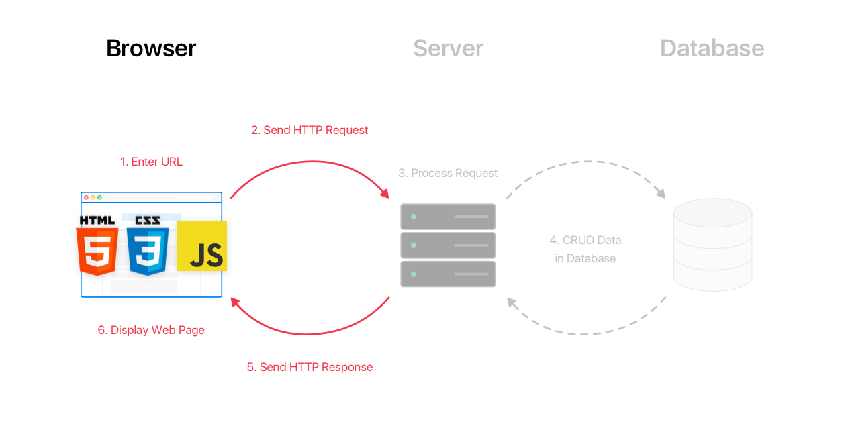
What is JavaScript ?
Client-side script: Code that runs on the user's computer and does not need a server to run (just a web browser!).
Client-side JavaScript runs as part of the browser's process to load HTML and CSS (e.g., from a server response). This JavaScript usually manipulates the page or responds to user actions through "event handlers”.

Slide 10
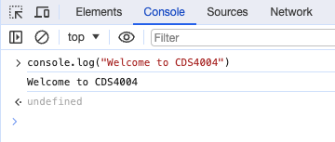
First step in JS
As an interpreted programming language, JS can be interacted with a line at a time.
We can make use of Chrome browser's Console tab in the same inspector tool you've used to inspect your HTML/CSS
Recommend using this console to get familiar with the basic syntax and behaviour.

Slide 11
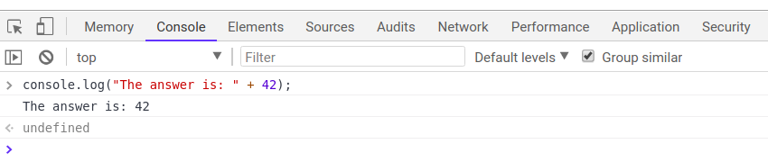
Console.log
Used to output values to the browser console, most often used to debug JS programs.
console.log(“message”);
JS
console.log(“The answer is ” + 42);
JS

Slide 12
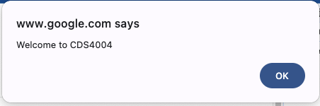
The alert function
A JS function that pops up a dialog box with a message
Not ideal in practice,
Can be a debugging tool when first learning JS
alert("message");
JS
alert(”Welcome to CDS4004");
JS

Slide 13
Comments
// single-line comment
/**
* multi-line
* comment
*/
JS
Recall: 3 comment syntaxes
HTML: <!-- comment -->
CSS/JS: /* comment */
JS:
// single comment
/* multi-line */

Slide 14
Variables
// template
let name = expression;
// examples
let level = 23;
let accuracyRate = 0.99;
let name = ”CDS4004";
JS
Variables are declared with the let keyword (case-sensitive).
You may also see var used instead of let
var is an older convention with weaker scope.

Slide 15
Variable Scope
A variable may belong to one of the following scopes:
Global scope: The default scope for all code running in script mode.
Function scope: The scope created with a function.
In addition, variables declared with let can belong to an additional scope: Block scope:
The scope created with a pair of curly braces.
When you declare a variable outside of any function, it is called a global variable
It is available to any other code in the current document.
When you declare a variable within a function, it is called a local variable.
It is available only within that function.

Slide 16
Variable Scope
if (Math.random() > 0.5) {
var y = 5;
}
console.log(y);
//The scope of y is not limited to the immediate if statement block.
if (Math.random() > 0.5) {
let y = 5;
}
console.log(y);
// ReferenceError: y is not defined
JS
JS
Since var is not restricted in block scope. y is a global variable.
Since let is belong to the Block scope. y can only be access within the if block. Outside the if block, y cannot be accessed.

Slide 17
Data types in JS
let level = 23; // Number
let accuracyRate = 0.99; // Number
let name = ”CDS4004"; // String
let x = true;
let y – false;
let person = {firstName:”John”, lastName:”Doe”};
let temps = [55, 60, 57.5]; // Array
let date = new Date(“2022-03-25”)
let largeNum = BigInt("123456789012345678901234567890");
JS
Type are not specified, but JS does have types.
Number
BigInt
Boolean
String
Object (Object | Date | Array)
Function
Null
Undefined

Slide 18
A Note about Declaring Types in JavaScript
In a dynamically-typed language like JavaScript/Python
we don't need to specify the type (just use let or const)
we may change the type the variable refers to later in execution.
let isValid = true;
isValid = "hello!";
isValid = 1;
isValid = true;
JS

Slide 19
Number Type
let enrollment = 99;
let medianGrade = 2.8;
let credits = 5 + 4 + (2 * 3);
JS
Integers and real numbers are the same type (no int vs. double).
All numbers in JS are floating point numbers.
Operators and Precedence
++ | Increment | First
-- | Decrement | First
! | NOT | First
*, /, % | Multiplication, division, modulus | Second
+, - | Addition, subtraction | Third
+ | Concatenation | Third
<, <= | Less than, less than, or equal | Fourth
>, >= | Greater than, greater than, or equal | Fourth
== | Equal | Fifth
!= | Not equal | Fifth
=== | Identity | Fifth
!== | Non-identity | Fifth
&& | AND | Sixth
|| | OR | Sixth
?: | Ternary | Seventh
= | Assignment | Eighth
+=, -=, and so on. | Arithmetic assignment | Eighth

Slide 20


Number Type
Many operators auto-convert types: "2" * 3 is 6
NaN ("Not a Number") is a return value from operations that have an undefined numerical result (e.g. dividing a String by a Number).

Slide 21
String type
let courseName = ”CDS4004 Web Technologies and Social Networks";
let courseCode = courseName.substring(0, courseName.indexOf(" ")); // ”CDS4004"
let len = courseName.length; // 15
let instructor = 'Ken'; // can use "" or ''
JS
charAt() | Returns the character at a specified index (position)
charCodeAt() | Returns the Unicode of the character at a specified index
endsWith() | Returns if a string ends with a specified value
fromCharCode() | Returns Unicode values as characters
indexOf() | Returns the index (position) of the first occurrence of a value in a string
lastIndexOf() | Returns the index (position) of the last occurrence of a value in a string
length | Returns the length of a string
replace() | Searches a string for a pattern, and returns a string where the first match is replaced
replaceAll() | Searches a string for a pattern and returns a new string where all matches are replaced
search() | Searches a string for a value, or regular expression, and returns the index (position) of the match
slice() | Extracts a part of a string and returns a new string
split() | Splits a string into an array of substrings
startsWith() | Checks whether a string begins with specified characters
substr() | Extracts a number of characters from a string, from a start index (position)
substring() | Extracts characters from a string, between two specified indices (positions)
toLowerCase() | Returns a string converted to lowercase letters
toUpperCase() | Returns a string converted to uppercase letters

Slide 22
More about Strings
Escape sequences: \' \" \& \n \t \\
To convert between Numbers and Strings:
To access characters of a String s, use s[index] or s.charAt(index):
let count = 10; // 10
let stringedCount = "" + count; // "10"
let puppyCount = count + " puppies, yay!"; // "10 puppies, yay!"
let magicNum = parseInt("42 is the answer"); // 42
let mystery = parseFloat("Am I a number?"); // NaN
JS
let firstLetter = puppyCount[0]; // "1"
let fourthLetter = puppyCount.charAt(3); // "p"
let lastLetter = puppyCount.charAt(puppyCount.length - 1); // "!”
JS

Slide 23
Common Bugs when Using Strings
There are a few special cases that you should be aware of.
Remember that length is a property (not a method)
Concatenation with +:
1 + 1 is 2.
but "1" + 1 and 1 + "1" are both "11"!

Slide 24
Special Values: null and undefined.
let foo = null;
let bar = 9;
let baz;
/* At this point in the code,
* foo is null
* bar is 9
* baz is undefined
*/
JS
undefined: declared but has not yet been assigned a value
null: is an empty or non-existent value. MUST be assigned.
let a = null;
let b;
let c = undefined;
let d = {}
console.log(a)
console.log(b)
console.log(c)
console.log(d.fake)
null and undefined are false values.
null !== undefined but null == undefined.

Slide 25
Array (Python List)
let name = []; // empty array
let names = [value, value, ..., value]; // pre-filled
names[index] = value; // store element
JS
let types = ["Electric", "Water", "Fire"];
let pokemon = []; // []
pokemon[0] = "Pikachu"; // ["Pikachu"]
pokemon[1] = "Squirtle"; // ["Pikachu", "Sqiurtle"]
pokemon[3] = "Magikarp"; // ["Pikachu", "Sqiurtle", undefined, "Magikarp"]
pokemon[3] = "Gyarados"; // ["Pikachu", "Sqiurtle", undefined, "Gyarados"]
JS
Two ways to initialize an array
length property (grows as needed when elements are added)

Slide 26
JavaScript Statements
JavaScript statements consists of keywords used with the appropriate syntax.
A single statement may span multiple lines.
Multiple statements may occur on a single line if each statement is separated by a semicolon (;).
Common JavaScript Statements:-
block statement
return statement
break statement
continue statement
if-else statement
switch statement
for statement
while statement
do-while statement

Slide 27
JavaScript Statement
block Statement
It is used to group zero or more statements.
The block is delimited by a pair of curly brackets.
{
statement_1;
statement_2;
…
statement_n;
}

Slide 28
JavaScript Statement
return Statement
It is used to specify the value to be returned by a function.
return [expression];

Slide 29
JavaScript Statement
break Statement
It terminates the current loop, switch, or label statement.
It transfers program control to the statement following the terminated statement.
continue Statement
It terminates execution of the statements in the current iteration of the current or labeled loop.
It continues execution of the loop with the next iteration.
break;
continue;

Slide 30
JavaScript Statement
if-else Statement
It executes a statement if a specified condition is true.
If the condition is false, another statement can be executed.

Slide 31
JavaScript Statement
switch Statement
It evaluates an expression, matching the expression’s value to a case label.
It executes statements associated with that case.
If no matching label is found, the default clause will be executed.
The optional break statement ensure that the program breaks out of switch once the matched statement is executed.
switch (expression) {
case label1:
statements1
[break;]
case label2:
statements2
[break;]
…
case labelN:
statementsN
[break;]
default:
statements_default
[break;]
}

Slide 32
JavaScript Statement
for (i=0; i<3; i++)
{
j *= 2;
}
for Statement
It creates a loop that consists of three optional expressions, enclosed in parentheses and separated by semicolons, followed by a statement executed in the loop.
initial-expression
It is an expression, including assignment expressions, or variable declaration.
It is typically used to initialize a counter variable.
condition
It is an expression evaluated on each pass through the loop.
If this condition evaluates to true, statements are executed.
This conditional test is optional. If omitted, the condition always evaluates to true.
increment-expression
It is generally used to update or increment the counter variable.
for ([initial-expression]; [condition]; [increment-expression]) {
statements
}

Slide 33
JavaScript Statement
i =0
while (i<3) {
j*= 2
i++
}
while Statement
It creates a loop that executes specified statements as long as the test condition evaluates to true.
The condition is evaluated before executing the statement.
condition
It is an expression evaluated before each pass through the loop.
If this condition evaluates to true, statement is executed.
When condition evaluates to false, execution continues with the statement after the while loop.
while (condition) {
statements
}

Slide 34
JavaScript Statement
i =0
do {
j*= 2;
i++;
} while (i < 3);
do-while Statement
It creates a loop that executes specified statements until the test condition evaluates to false.
The condition is evaluated after executing the statement, resulting the specified statement executing at least once.
condition
An expression is evaluated after each pass through the loop.
If condition evaluates to true, the statement is re-executed.
When condition evaluates to false, control passes to the statement following the do...while.
do {
statements
} while (condition);

Slide 35
JavaScript Functions
A function is a “subprogram”, that can be called by code external to the function.
Like the program itself, a function is composed of a sequence of statements, called the function body.
Objects and values can be passed to a function, and the function can return an object or value.
To return a value, the function must have a return statement that specifics the value to return.

Slide 36
JavaScript Functions
Non-object parameters, such as strings, numbers and booleans, are passed to functions by value.
The value is passed to the function where it is stored in a new variable.
If the function changes the value of the variable, the change is not reflected globally or in the calling function.
Object parameters, such as objects, arrays are passed to functions by reference.
If the function changes the object’s properties, that change is visible outside the function.

Slide 37
JS Function vs Python Function
def repeat(str, n):
result = str
for i in range(1, n):
result = result + str;
return result
repeatedStr = repeat(“echo...”, 3); //echo...echo...echo...
Python
function repeat(str, n):
let result = str;
for (let i = 1; i < n; i++ ) {
result += str
}
return result;
}
let repeatedStr = repeat(“echo...”, 3); //echo...echo...echo...
JS

Slide 38
Define Functions
function name(param1, param2, ..., paramN) {
statement;
statement;
...
statement;
}
// example
function myFunction() {
console.log("Hello!");
alert("Your browser says hi!");
}
JS
name: the name of the function.
param (up to 255 arguments): It is the name of an argument to be passed to the function.
statements: refer to the statements comprising the body of the function.
return statement: used to specify the value that is returned from the function

Slide 39
Linkage between HTML/JS
In general, to add interactivity to our HTML/CSS websites we need to
Link a JS program to our HTML (in the <head>)
Identify the elements we want to "listen" to user/page events
Identify the events we want to respond to
Identify what each response function is
Assign the listener elements the functions when the event(s) occurs! own event(s) to listen to

Slide 40
Include a JS file in HTML
// template
<script src=“filename”></script>
// template
<script src=“example.js”></script>
JS
The <script> tag should be placed in the HTML page's <head>. All JavaScript code used in the page should be stored in a separate .js file.
JS code can be placed directly in the HTML file's body or head (like CSS), but this is poor code quality. You should always separate content, presentation, and behavior by keeping these "concerns" in separate files!!

Slide 41
Event Listeners

Slide 42
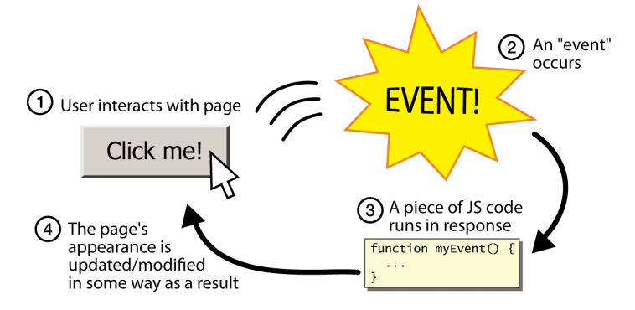
Event Driven Programming
JS responds to user actions called events
Event-Driven Programming: writing programs driven by user events

Slide 43
Accessing an element by id
let name = document.getElementById(“id”)
JS
document.getElementById(id) returns the DOM object for an element with a given id
Note that you omit the # when giving an id
There are other ways to get DOM elements:
document.getElementsByClassName
document.getElementsByTagName
document.querySelector
document.querySelectorAll

Slide 44
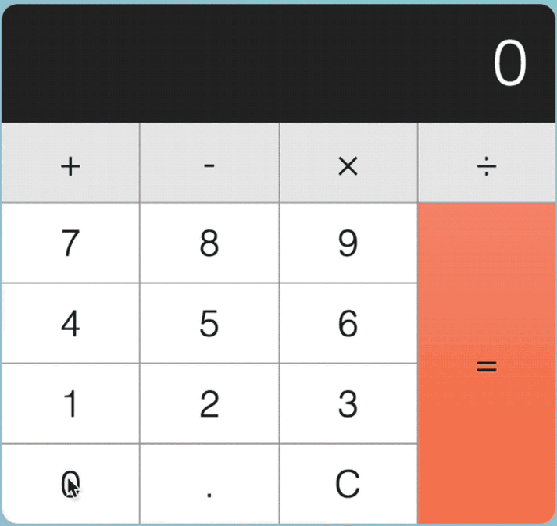
Accessing elements by Class Name
function numberOnClick() {
console.log(this);
}
document.addEventListener('DOMContentLoaded', function()
{
let digitBtns = document.getElementsByClassName(‘digit’);
for( let i=0; i<digitBtns.length; i++ ) {
digitBtns[i].addEventListener('click’, digitOnClick);
}
}
JS
this refers to the clicked element
<div id="numbers">
<p class="digit">7</p>
<p class="digit">8</p>
<p class="digit">9</p> ...
<p class="digit zero">9</p>
</div>
HTML

Slide 45
Query Selector Examples
document.querySelector(selector)
Returns the first element that would be matched by the given CSS selector string
document.querySelectorAll(selector)
Returns an array of all elements that would be matched by the given CSS selector string
let myClass = document.querySelector(".myclass");
JS
let digitBtn = document.querySelector("div#calculator p.digit.zero");
JS
let digitBtns = document.querySelectorAll("div#calculator p.digit");
JS

Slide 46
Shortcut Functions
We can declare a shortcut to help us.
You may use the following in your JS programs.
function id(id) {
return document.getElementById(id);
}
function qs(selector) {
return document.querySelector(selector);
}
function qsa(selector) {
return document.querySelectorAll(selector);
}
JS

Slide 47
What’s inside a DOM ?
<img src="images/puppy.png" alt="A fantastic puppy photo">
HTML
This HTML above is a DOM object with these two attributes:
puppyImg.src - set by the browser to images/puppy.png
puppyImg.alt - set by the browser to "A fantastic puppy photo"

Slide 48
What’s inside a DOM ?

Slide 49

What’s inside a DOM ?
<html>
<head>
<title>My Fancy Title</title>
<meta charset="UTF-8">
<link rel="stylesheet" href="styles.css">
<script src="script.js"></script>
</head>
<body>
<header>...</header>
<nav>...</nav>
<article>
<section>
<p>Hello world: <a href="...">here</a></p>
<p>Welcome!</p>
<img src="...">
<a href="...">citation</a>
</section>
</article>
<footer>
<a href="..."></a>
</footer>
</body>
</html>

Slide 50
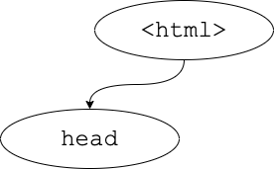
What’s inside a DOM ?
<html>
<head>
<title>My Fancy Title</title>
<meta charset="UTF-8">
<link rel="stylesheet" href="styles.css">
<script src="script.js"></script>
</head>
<body>
<header>...</header>
<nav>...</nav>
<article>
<section>
<p>Hello world: <a href="...">here</a></p>
<p>Welcome!</p>
<img src="...">
<a href="...">citation</a>
</section>
</article>
<footer>
<a href="..."></a>
</footer>
</body>
</html>

Slide 51
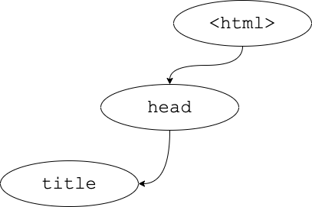
What’s inside a DOM ?
<html>
<head>
<title>My Fancy Title</title>
<meta charset="UTF-8">
<link rel="stylesheet" href="styles.css">
<script src="script.js"></script>
</head>
<body>
<header>...</header>
<nav>...</nav>
<article>
<section>
<p>Hello world: <a href="...">here</a></p>
<p>Welcome!</p>
<img src="...">
<a href="...">citation</a>
</section>
</article>
<footer>
<a href="..."></a>
</footer>
</body>
</html>

Slide 52
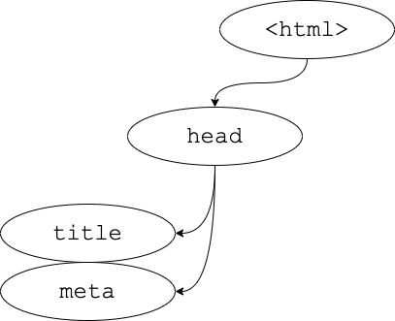
What’s inside a DOM ?
<html>
<head>
<title>My Fancy Title</title>
<meta charset="UTF-8">
<link rel="stylesheet" href="styles.css">
<script src="script.js"></script>
</head>
<body>
<header>...</header>
<nav>...</nav>
<article>
<section>
<p>Hello world: <a href="...">here</a></p>
<p>Welcome!</p>
<img src="...">
<a href="...">citation</a>
</section>
</article>
<footer>
<a href="..."></a>
</footer>
</body>
</html>

Slide 53
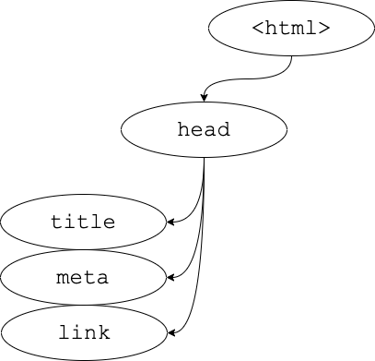
What’s inside a DOM ?
<html>
<head>
<title>My Fancy Title</title>
<meta charset="UTF-8">
<link rel="stylesheet" href="styles.css">
<script src="script.js"></script>
</head>
<body>
<header>...</header>
<nav>...</nav>
<article>
<section>
<p>Hello world: <a href="...">here</a></p>
<p>Welcome!</p>
<img src="...">
<a href="...">citation</a>
</section>
</article>
<footer>
<a href="..."></a>
</footer>
</body>
</html>

Slide 54
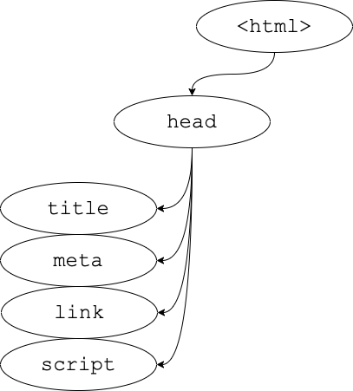
What’s inside a DOM ?
<html>
<head>
<title>My Fancy Title</title>
<meta charset="UTF-8">
<link rel="stylesheet" href="styles.css">
<script src="script.js"></script>
</head>
<body>
<header>...</header>
<nav>...</nav>
<article>
<section>
<p>Hello world: <a href="...">here</a></p>
<p>Welcome!</p>
<img src="...">
<a href="...">citation</a>
</section>
</article>
<footer>
<a href="..."></a>
</footer>
</body>
</html>

Slide 55
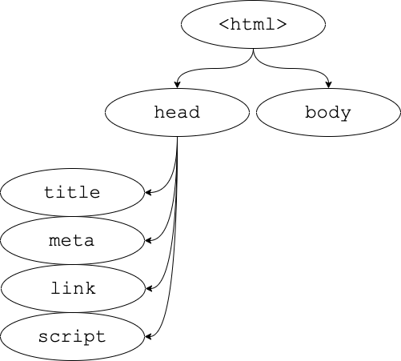
What’s inside a DOM ?
<html>
<head>
<title>My Fancy Title</title>
<meta charset="UTF-8">
<link rel="stylesheet" href="styles.css">
<script src="script.js"></script>
</head>
<body>
<header>...</header>
<nav>...</nav>
<article>
<section>
<p>Hello world: <a href="...">here</a></p>
<p>Welcome!</p>
<img src="...">
<a href="...">citation</a>
</section>
</article>
<footer>
<a href="..."></a>
</footer>
</body>
</html>

Slide 56
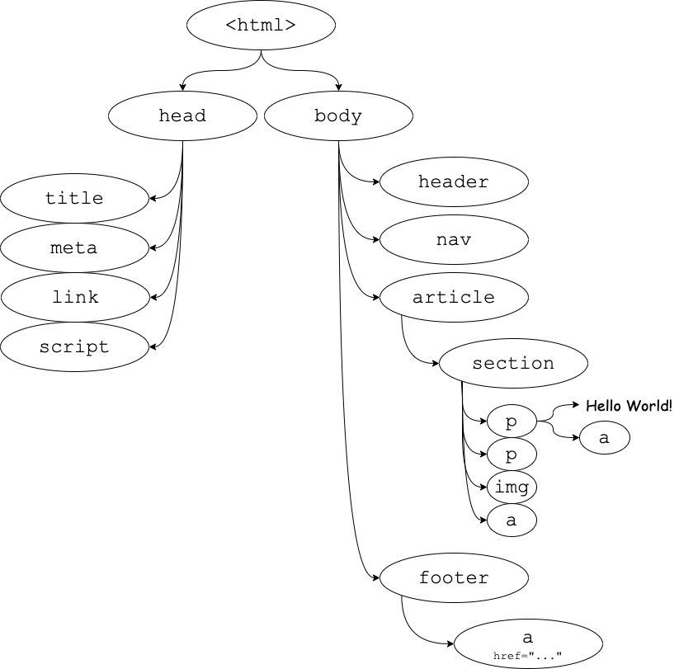
Full DOM
Each node in the tree has:
Name of element
Attributes, and their values
Content (if any)

Slide 57
The <button>
Text inside of the button tag renders as the button text
To make a responsive button (or other UI controls):
Choose the control (e.g., button) and event (e.g., mouse click) of interest
Write a JavaScript function to run when the event occurs
Attach the function to the event on the control
<button id="my-btn">Go!</button>
HTML

Slide 58
Listening & Responding to Events addEventListener
// attaching a named function
element.addEventListener("click", handleFunction);
function handleFunction() {
// event handler code
}
JS
JavaScript functions can be set as event handlers
When you interact with the element and trigger the event, the callback function will execute
click is just one of many event types we will use. The full list of UIEvents are located here: https://developer.mozilla.org/en-US/docs/Web/API/UI_Events

Slide 59
Event handler syntax
What’s the difference between these two?
addEventListener("click", openBox);
addEventListener("click", openBox());

Slide 60
Event handler syntax
What’s the difference between these two?
addEventListener("click", openBox);
addEventListener("click", openBox());

Slide 61
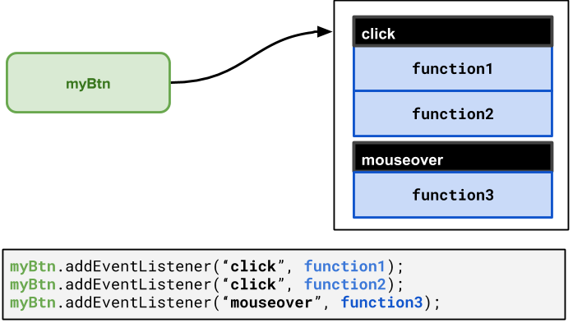
addEventListener with multiple events

Slide 62
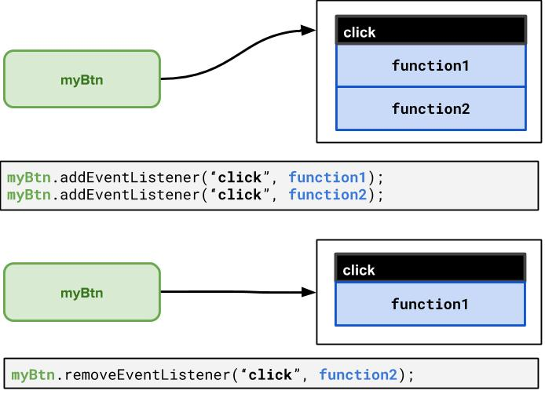
removeEventListener

Slide 63
Event Objects!
Recall that the event handler function can be attached to objects (window, DOM elements, etc.)
When the event occurs, an Event object is created and passed to the event listener. You can "catch" this event object as an optional first parameter to get more information about the event.
source.addEventListener("click", responseFunction);
function responseFunction(e) {
// we can access the click Event object here!
}
JS

Slide 64
Using a click Event Handler to Open the Box
<img id=”box" src="question-block.png" alt="A Box">
<button id="box-btn">Click me!</button>
HTML
let boxBtn = document.getElementById("box-btn");
boxBtn.addEventListener("click", openBox);
function openBox() {
// 1. Get the box image
let box = document.getElementById(”box");
// 2. Change the box image's src attribute! box.src = "star.png";
}
JS

Slide 65
Listening to the window “load” event
You can only access document element after the “load” event has fired
document.addEventListener('DOMContentLoaded', function()
{
// we now have access to the DOM tree!
// set up your initial document event handlers here.
});
JS

Slide 66
DOM Manipulation: Classes

Slide 67
Hiding/Showing Elements
How can we hide an HTML element?
In JS, it’s possible to modify the style properties of an element directly
What’s wrong with the method above?
.hidden {
display: none;
}
id("my-img").style.display = "none";

Slide 68
Modifying the classList
You can manipulate the DOM element’s classList with the following methods:
Name | Description
add(classname) | Adds the specified class(es) to the list of classes on this element. Any that are already in the classList are ignored.
remove(classname) | Removes the specified class(es) to the list of classes from this element. Any that are already not in the classList are ignored without an error
toggle(classname) | Removes a class that is in the list, adds a class that is not in the list.
contains(classname) | Returns true if the class is in the DOM element's classList, false if not.
replace(oldclass, newclass) | Replaces the old class with the new class.

Slide 69
Any questions?

